Slide 1
Mobile Safety Paper
-Summary Slides
Jenny Gong

Slide 2
Problem Statement
“Everyone” is one of the four maturity rating levels on Android platform, which represents that the app is safe and can be played for everyone, including kids. However, is the “Everyone” app actually contains no adult content at all? Is the “Everyone” App really safe for your kids?
Actually, our study finds that it is not necessarily the case. Some of the “Everyone” app contains adult content such as violence or sexual themes, which is apparently not suitable for little kids. The Android platform uses self-report system to determine the app maturity rating. Therefore, it gives developers opportunities to underrate their games, so that they can gain more downloads for their game apps.
This study is to detect those “Everyone” game apps which should be categorized as “Everyone 10+”, “Teen”, or even “Maturity 17+”, due to the adult content they contain.

Slide 3
System Design
Add seed terms
Adjust weights
Ontology
(Terms + Weights)
Reinforcement
Output
“Description”
“user reviews”
ALM
Our own model (Similarity, KNN, Naive Bayes…. )
Model Rating
Input
False Positive
False Negative
Output
Text Classification Model
Non-consistent
apps
Gap Analysis
Mturk Rating
Output
Input
Prediction Model (Text input + numeric input)
Numeric Variable
(Version, Popularity, developer…)
Notes:
-No ‘user review’ input text for now
-Need to generate 2 ALM model for iOS, Android???

Slide 4
Algorithm 1 – Strong Vocabulary

Slide 5
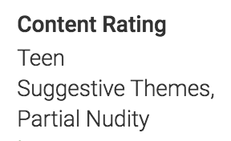
Step 1: Identify reason for maturity rating
“Sex” feature
Step 2: Tag each app based on feature, generate app dataset for each feature
Feature | Violence | Fantasy Violence | Alcohol Drug Tobacco | Sex | Language | Gambling
# Apps | 2347 | 2045 | 184 | 221 | 262 | 1811
Step 3. Generate key word frequency distribution for each feature
Frequency, Normalized Frequency
Step 4. Build lexicon
Ratio
Step 5. Human screening, human adding
Step 6. Testing Lexicon -> suspicious apps

Slide 6
Step 3. Generate key word frequency distribution for each feature
Tokenize, stop word removal
Stemming: PorterStemmer()
Frequency distribution for each feature: FreqDist()
Aggregate word frequency of each feature for every token, calculate total frequency of each token

Slide 7
Step 3. Generate key word frequency distribution for each feature
5. Normalization
Feature | Violence | Fantasy Violence | Alcohol Drug Tobacco | Sex | Language | Gambling
# Apps | 2347 | 2045 | 184 | 221 | 262 | 1811
“Sex”, “Language”, “ADT” has much fewer apps than the other three features.
Normalization
Final Distribution: tokens.xlsx
Notes:
公式

Slide 8
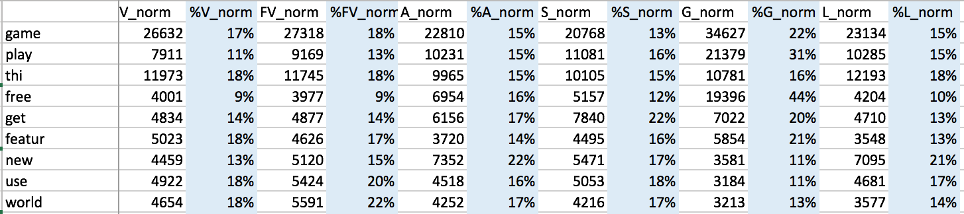
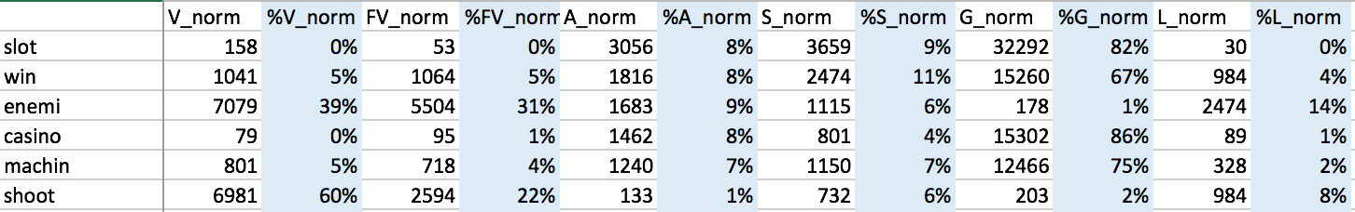
Step 4: Build Lexicon
Equally Distributed words -> Stop words
1) Calculate “Ratio”
For each word:
%V = V_freq / Total_freq
%FV = FV_freq / Total_freq
%A = A_freq / Total_freq
%S = S_freq / Total_freq
%G = G_freq / Total_freq
%L = L_freq / Total_freq
Unequally Distributed words -> Lexicon

Slide 9
Step 4: Build Lexicon
2) Lexicon select rules:
1. Big head: 1 feature distribution > 80%
2. Big head: 2 features distribution > 85%
V + FV > 85% (they are similar)
3. Small tail: 3 features distribution < 5%

Slide 10
Step 5. Human screening, human adding
1) Human expert screening all the lexicon
-Categorize each feature into “Strong list” and “Weak list”
-Delete unreasonable words
-Delete “Language” feature
Top frequency words doesn’t make sense, hard to extract “strong language” content in app description
“Language” feature always come with other feature
2) Human expert add some words into the lexicon
“Sex”, “Alcohol, Drug, Tobacco” features have too few words, so add some words
Add “Direct warning” feature: “for adults”, “21 years older”
Final Lexicon: Lexicon.xlsx

Slide 11
Step 6: Testing Lexicon -> Suspicious apps
Combine all “Strong list” into “Strong word list”
Identify strong words in each app description
Look at “Everyone” level
It shouldn’t contain any Strong Words!!
Strong word list = Violence_Strong + Sex_Strong + ADT_Strong + Gambling_Strong + DirectWarning_Strong

Slide 12

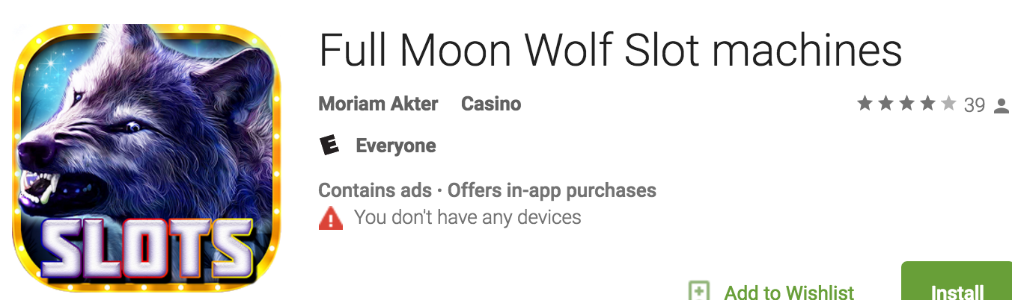
Suspicious app 1
8 Strong words!

Slide 13
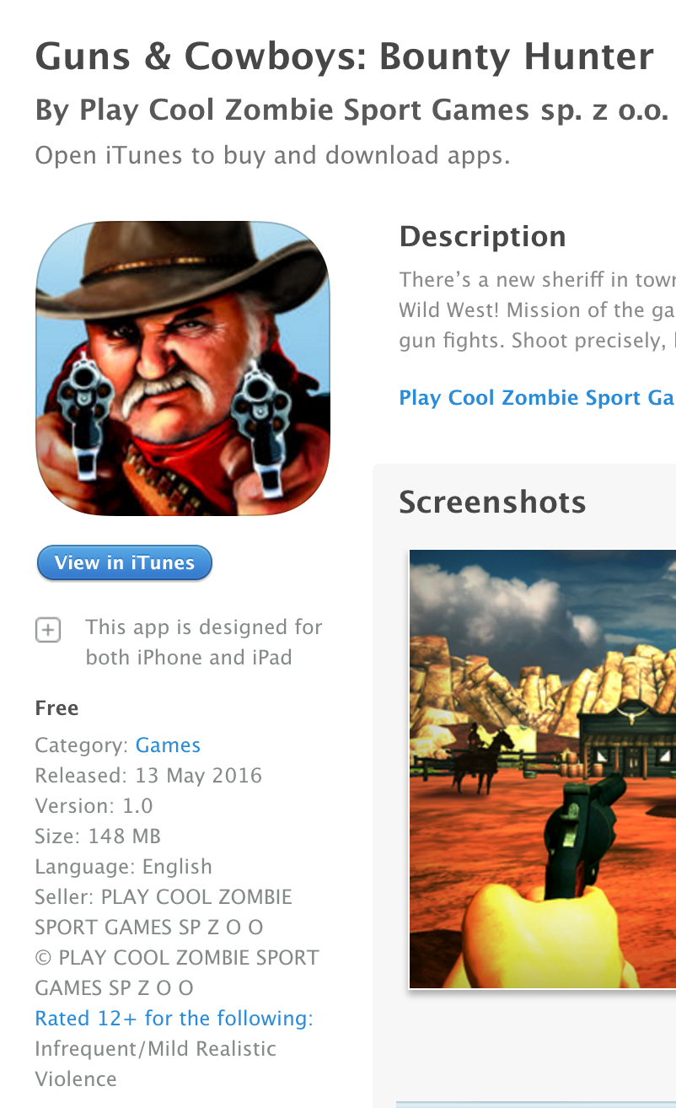
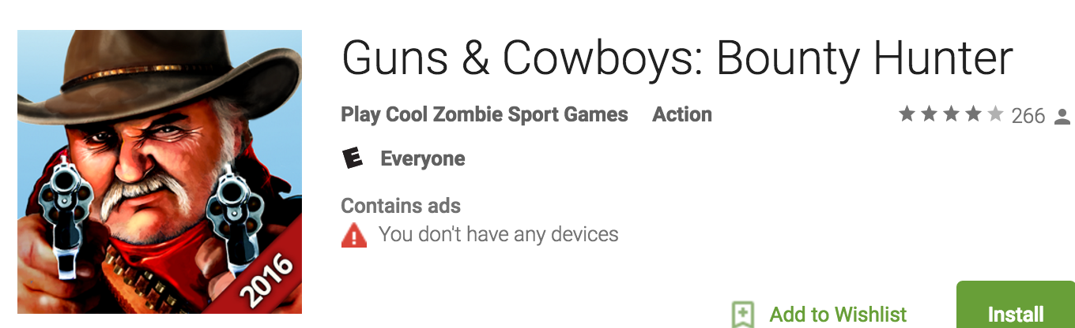
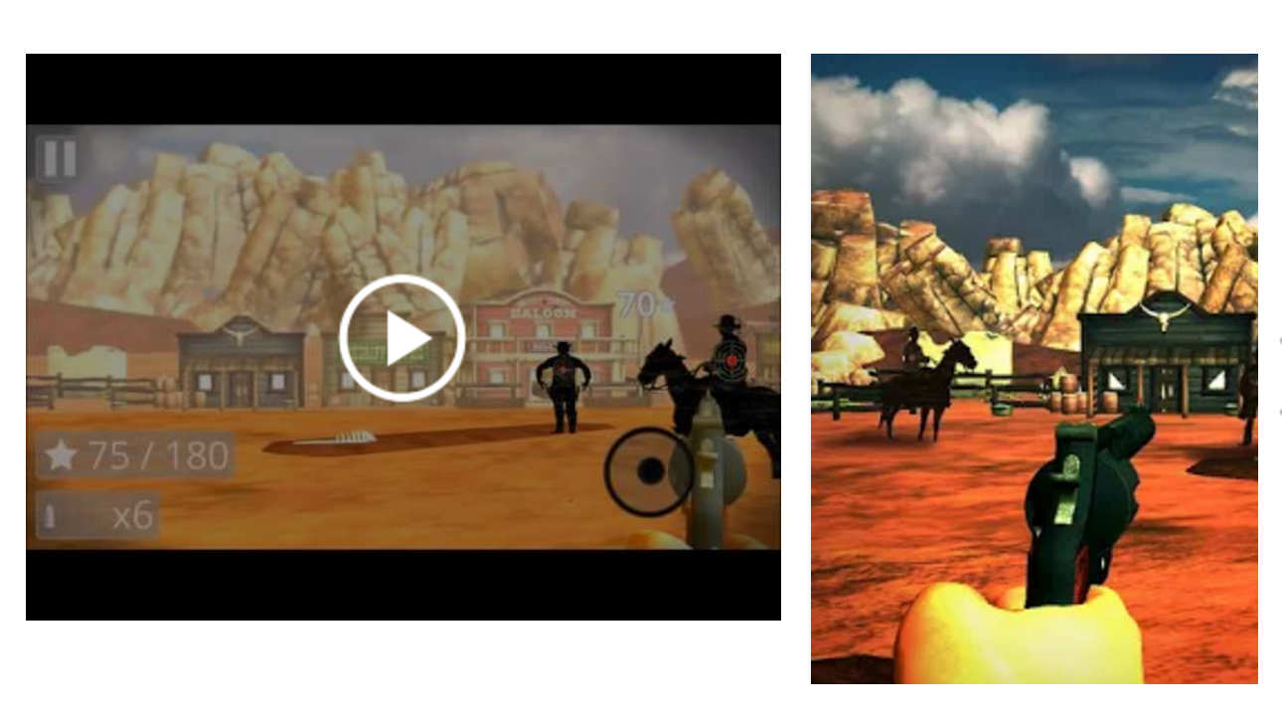
Suspicious app 2
iOS:
Android:
9 Strong words!

Slide 14
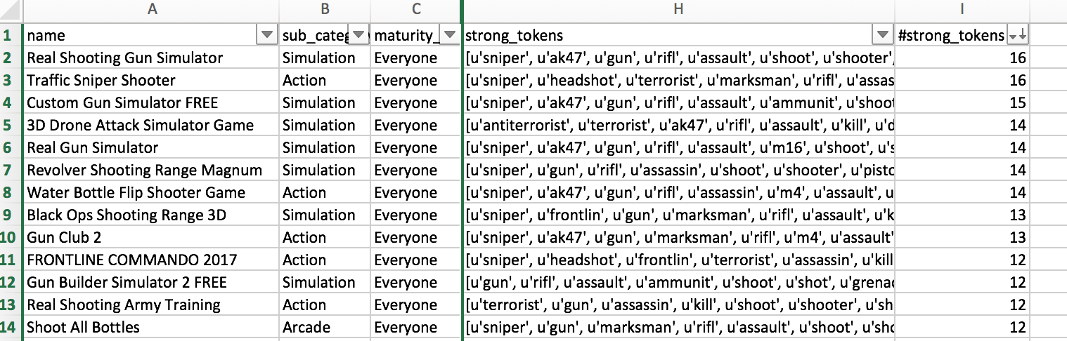
Suspicious apps in “Everyone” level
Suspicious_app_0314.xlsx
28,974 “Everyone” apps
Num of strong words in the app | 1 | 2 | 3 | 4 | 5 | 6 | 7 | 8 | 9 | 10 | 11 | 12 | 13 | 14 | 15 | 16 | Grand Total
Num of apps | 5528 | 1595 | 632 | 200 | 67 | 39 | 23 | 17 | 10 | 3 | 7 | 8 | 2 | 4 | 1 | 2 | 8138
54 apps: has more than 8 strong words in their description
1015 apps: has more than 3 strong words in their description

Slide 15
Algorithm 2 – Similarity

Slide 16
Similarity Steps
Freq + Control
Occur + Control
Frequency Matrix
Control Vocabulary
Find 10 Nearest Neighbors
Count how many apps rating are different
Sort descending, benchmark: #diff>=7
Tfidf + Control
Occurrence
Matrix
Cosine
Similarity
X
Freq + All
All Vocabulary
Tfidf
Matrix
Occur + All
Tfidf + All
Suspicious apps

Slide 17

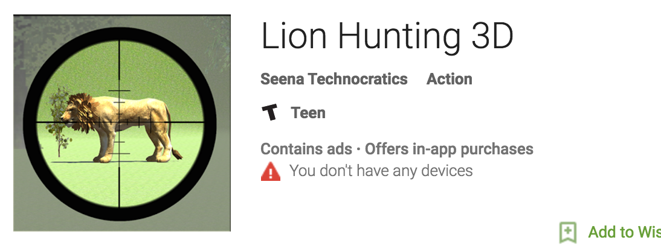

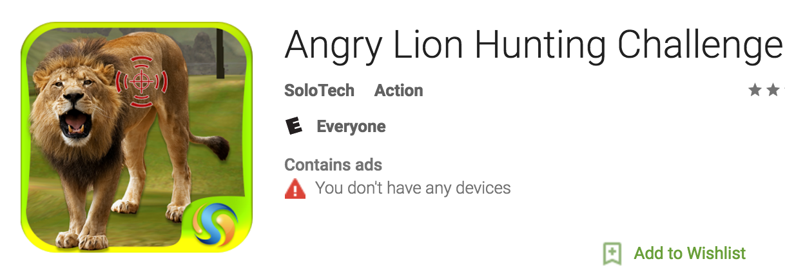

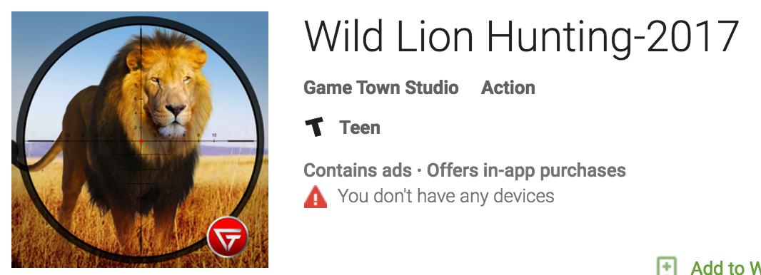

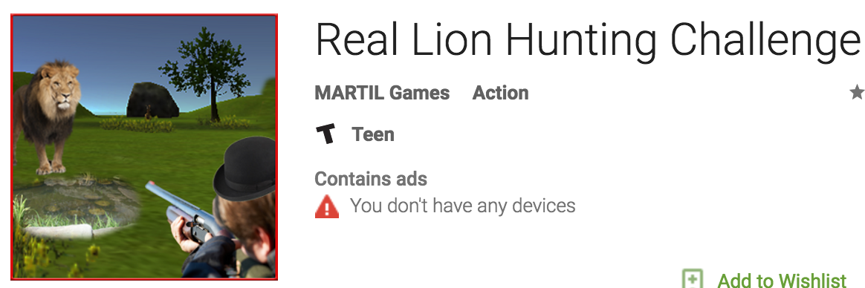


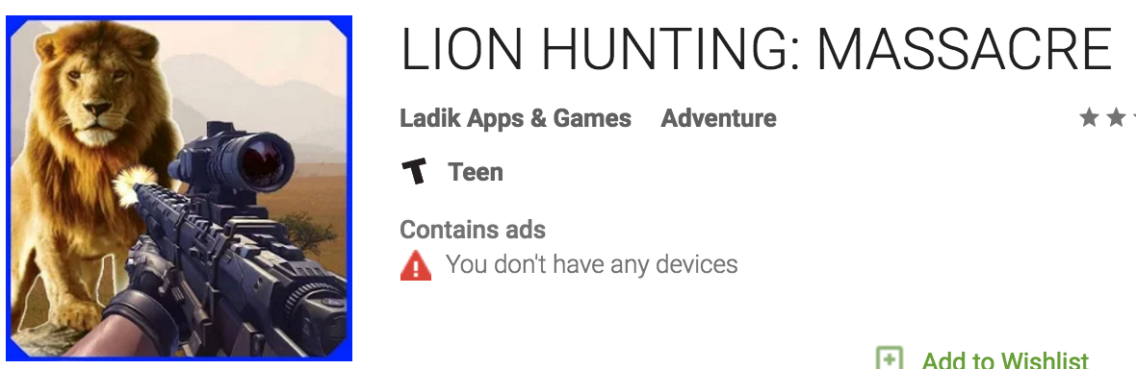
Teen
Teen
Teen
Everyone
Teen
Everyone 10+
Teen
Teen
Teen
Teen

Slide 18
Performance
Result_alltoken.xlsx
Number of different apps within 10 nearest neighbors >=7
Only look at ‘Everyone’ level
 | Freq + Control | Occur + Control | Tfidf + Control | Freq + All | Occur + All | Tfidf + All
Suspicious Apps Count | 182 | 116 | 190 | 323 | 270 | 321
False Positive | 39 | 19 | 71 | 70 | 115 | 76
FP% | 21.4% | 16.4% | 37.3% | 21.6% | 42.5% | 23.6%
False Positive: algorithm detect as suspicious app, but it actually should belong to ‘Everyone’ level.

Slide 19
Improvement
Control vocabulary: strong list * 2
In neighbors: ‘Maturity 17+’ *4, ‘Teen’ *3, ‘Everyone 10+’ *2

Slide 20
Ensemble

Slide 21
III. Ensemble 3 Algorithms
Matching (a)
Similarity (b)
Strong Vocabulary (c)
Suspicious
Probability
%
Match with 3,4 : 0.5
Match with 2 : 0.3
9-7 : 0.5
6-5 : 0.3
16-8: 0.8
7-5 : 0.5
4-1 : 0.3
a+(1-a)*b+{1-[a+(1-a)*b]}*c = Suspicious Probability (%)
Impact of a
Impact of b
Impact of c
100%
a+(1-a)*b
{1-[a+(1-a)*b]}*c
a
(1-a)*b
For example:
a= 0.5
b=0.2
c=0.8
0.5
(1-0.5)*0.2= 0.1
(1-0.6)*0.8= 0.32
92%

Slide 22
Compared with an Average approach
1. (a+b+c)/3
2. (a+b+c)/(number of non-zeros)
 | a | b | c
1) | 0.9 | 0 | 0
2) | 0.3 | 0.3 | 0.3
 | a | b | c
1) | 0.9 | 0.1 | 0
2) | 0.5 | 0 | 0
0.3
0.5
0.3
0.5
Will not show the strong suspicious probability

Slide 23
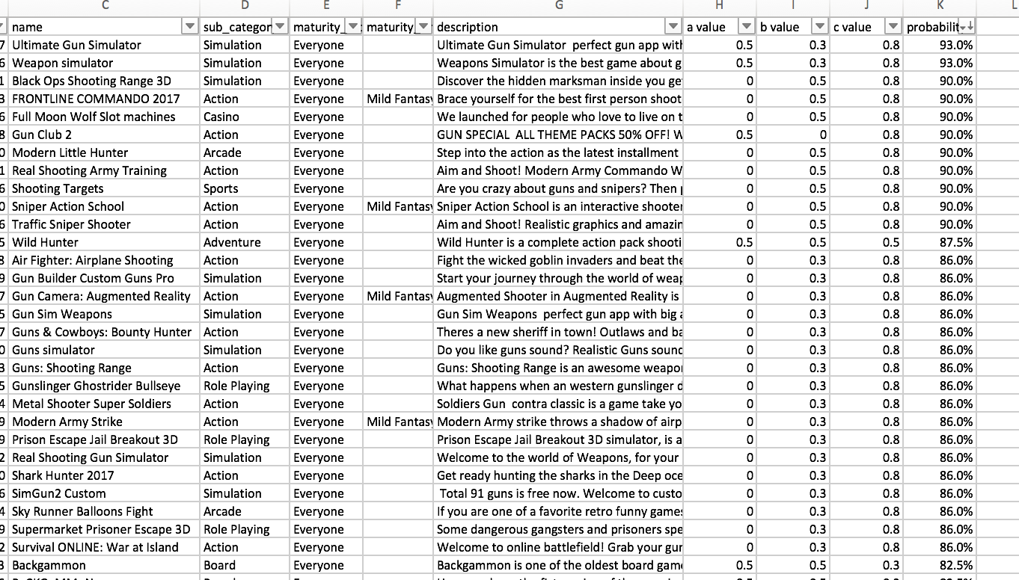
Suspicious Apps

Slide 24
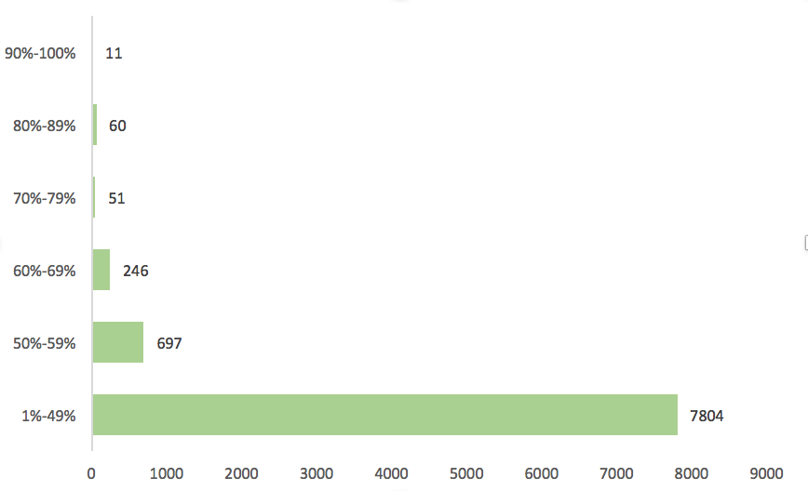
Suspicious Probability
0% | 1%-49% | 50%-59% | 60%-69% | 70%-79% | 80%-89% | 90%-100% | total
20105 | 7804 | 697 | 246 | 51 | 60 | 11 | 28974

